Slide 1
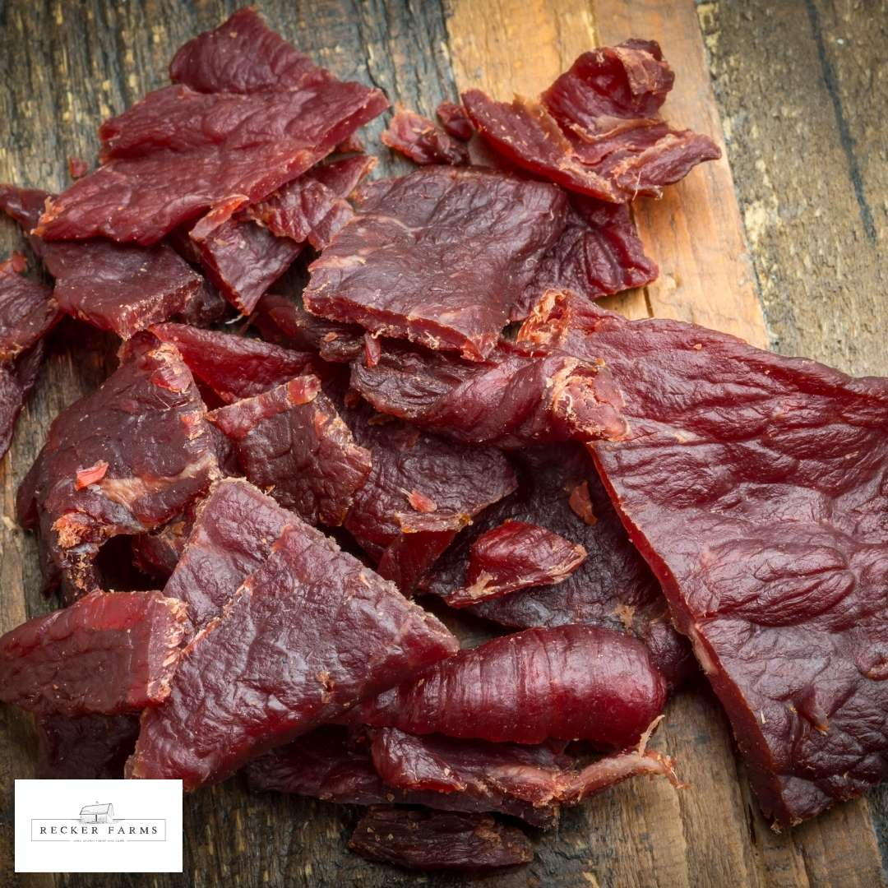

“Evaluating the survival of pathogenic bacteria in beef jerky”
Group Members-
Toma Ryan Jo

Slide 2
Background
“In recent times, the consumption of beef jerky has been linked to multiple illnesses and hospitalizations involving Escherichia coli or Salmonella and nationwide beef jerky recalls attributed to these pathogenic bacteria.”

Slide 3
Context
The beef jerky samples were divided into two main groups based on inoculation methods: Dry Inoculation and Wet Inoculation. Each of these main groups was further divided into sub-groups based on thickness: 1/4 and 1/8 inch.
The objective of the study was to determine the survival rates of Salmonella population when processed in a commercial dehydrator, as well as to assess the impact of inoculation method and thickness on the Salmonella population.

Slide 4
Matrix Diagram

Slide 5
Variables
Response Variable: Microbial counts
Fixed effect:
Inoculation method
2 methods: dry and wet
Thickness
2 levels: one-fourth and one-eighth of an inch
Random Effect:
Blocking (Batch)

Slide 6
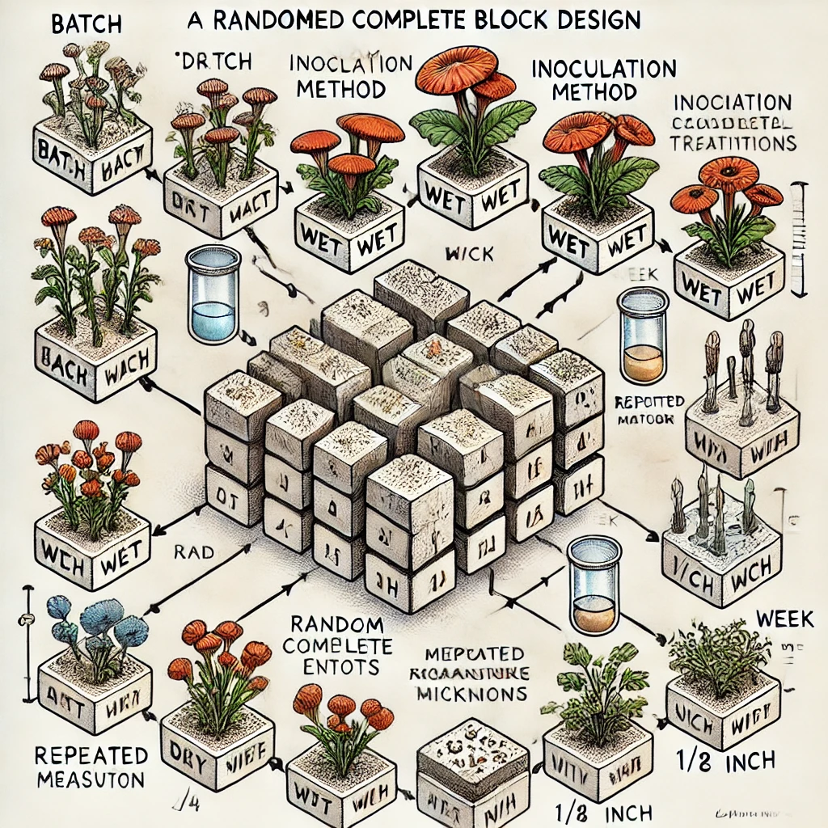
Model Design
Treatment Structure: A 2×2 factorial arrangement involving:
Factor 1: Inoculation Method (Dry, Wet)
Factor 2: Thickness (1/4 inch, 1/8 inch)
Plus repeated measures over Time (Week 0 to Week 4).
Design Structure: Likely a randomized complete block design (RCBD), where: Blocks (Batches) are a random effect. Treatments are combinations of the Inoculation Method and Thickness, with measurements taken over time.

Slide 7
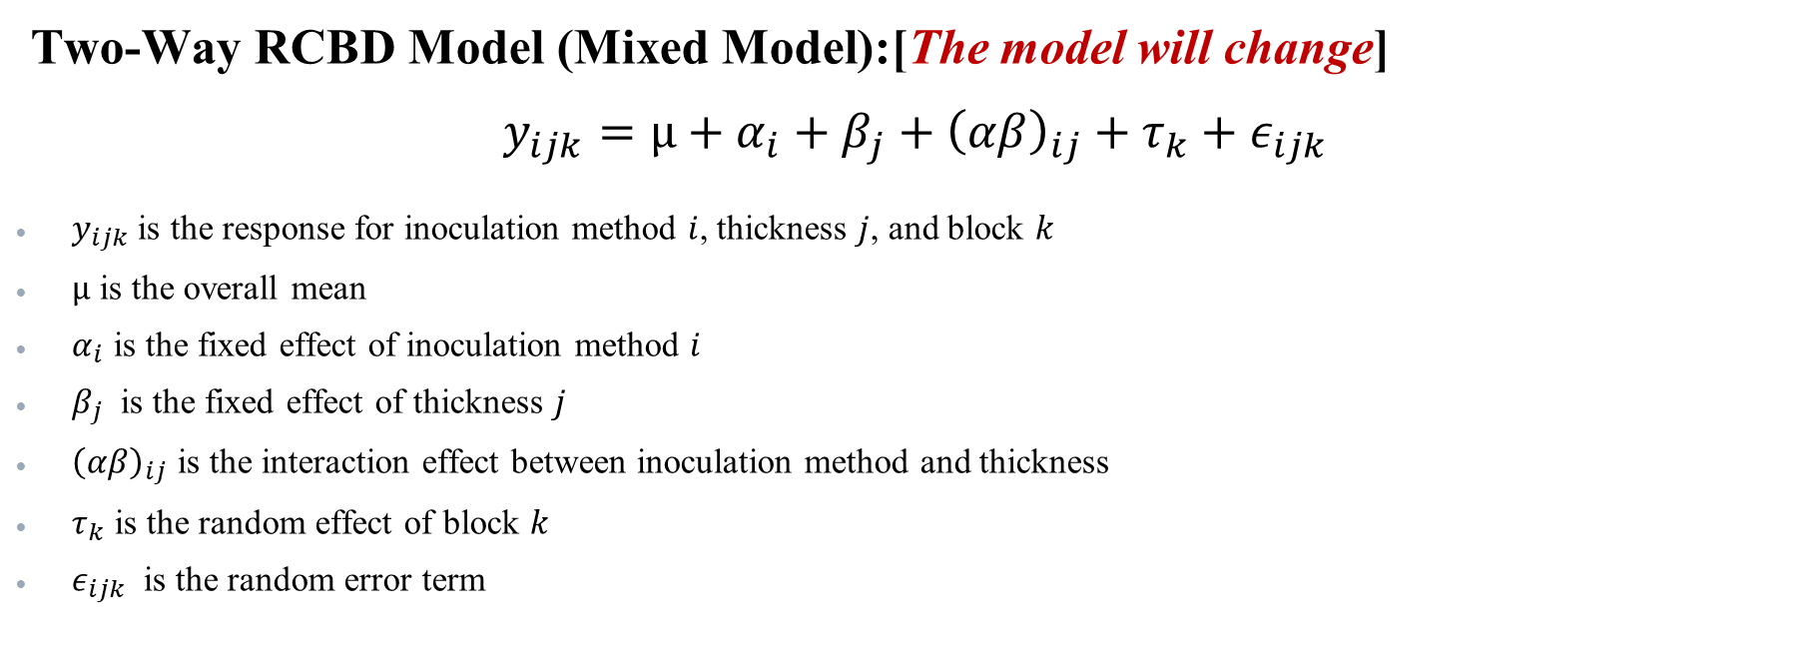
Experimental Design
Two-Way RCBD Model (Mixed Model):[The model will change]
$$y_{ijk}=µ+α_{i}+β_{j}+{\left(αβ\right)}_{ij}+τ_{k}+ε_{ijk}$$
$y_{ijk}$is the response for inoculation method $i$, thickness $j$, and block $k$
$µ$ is the overall mean
$α_{i}$ is the fixed effect of inoculation method $i$
$β_{j}$​ is the fixed effect of thickness $j$
${\left(αβ\right)}_{ij}$​ is the interaction effect between inoculation method and thickness
$τ_{k}$​ is the random effect of block $k$
$ε_{ijk}$ is the random error term

Slide 8
Simulated Dataset
Inoculation Method | Thickness | Week 1 | Week 2 | Week 3 | Week 4 | Week 5
Dry | 1/4' | 4.257 | 4.246 | 4.474 | 4.333 | 4.013
Dry | 1/8' | 5.291 | 4.951 | 5.201 | 5.207 | 4.971
Wet | 1/4' | 5.401 | 5.573 | 5.550 | 5.487 | 5.381
Wet | 1/8' | 5.560 | 5.779 | 5.631 | 5.715 | 5.620

Slide 9
Simulated Dataset

Slide 10
References
Brown, Jessica, et al. “Inactivation of Salmonella Enterica, Escherichia Coli O157:H7, and Campylobacter Jejuni in a Restructured Beef Jerky Developed for Production in Ethiopia.” Meat and Muscle Biology, vol. 8, no. 1, 22 Apr. 2024, www.iastatedigitalpress.com/mmb/article/id/16091/, https://doi.org/10.22175/mmb.16091. Accessed 26 Sept. 2024.
“Jerky and Food Safety | Food Safety and Inspection Service.” Usda.gov, USDA, 2023, www.fsis.usda.gov/food-safety/safe-food-handling-and-preparation/meat-fish/jerky. Accessed 25 Sept. 2024.
RANDOMIZED COMPLETE BLOCK DESIGN (RCBD). North Dakota State University. https://www.ndsu.edu/faculty/horsley/RCBD_revised_notes.pdf.
“Texas Firm Recalls Beef Jerky Products due to Possible Salmonella Contamination | Food Safety and Inspection Service.” Www.fsis.usda.gov, USDA, 7 Nov. 2011, www.fsis.usda.gov/recalls-alerts/texas-firm-recalls-beef-jerky-products-due-possible-salmonella-contamination. Accessed 25 Sept. 2024.

Slide 11
Thank You! Question?

Slide 12
Suggestions:
Add repeated measures. At least 5 weeks like 0, 1, 2, 3, 4 like this.
Response: Should count data with log
We didn’t finalize the model or model structure, right?

